Slide 1
Ultrasonic Sensor
HC-SR04

Slide 2
What is an Ultrasonic Sensor?
It is a sensor that measures the distance to an object using ultrasonic sound waves
They have two main components:
Transmitter
Receiver
Ultrasonic waves travels faster than the speed of the sound that humans can hear!

Slide 3
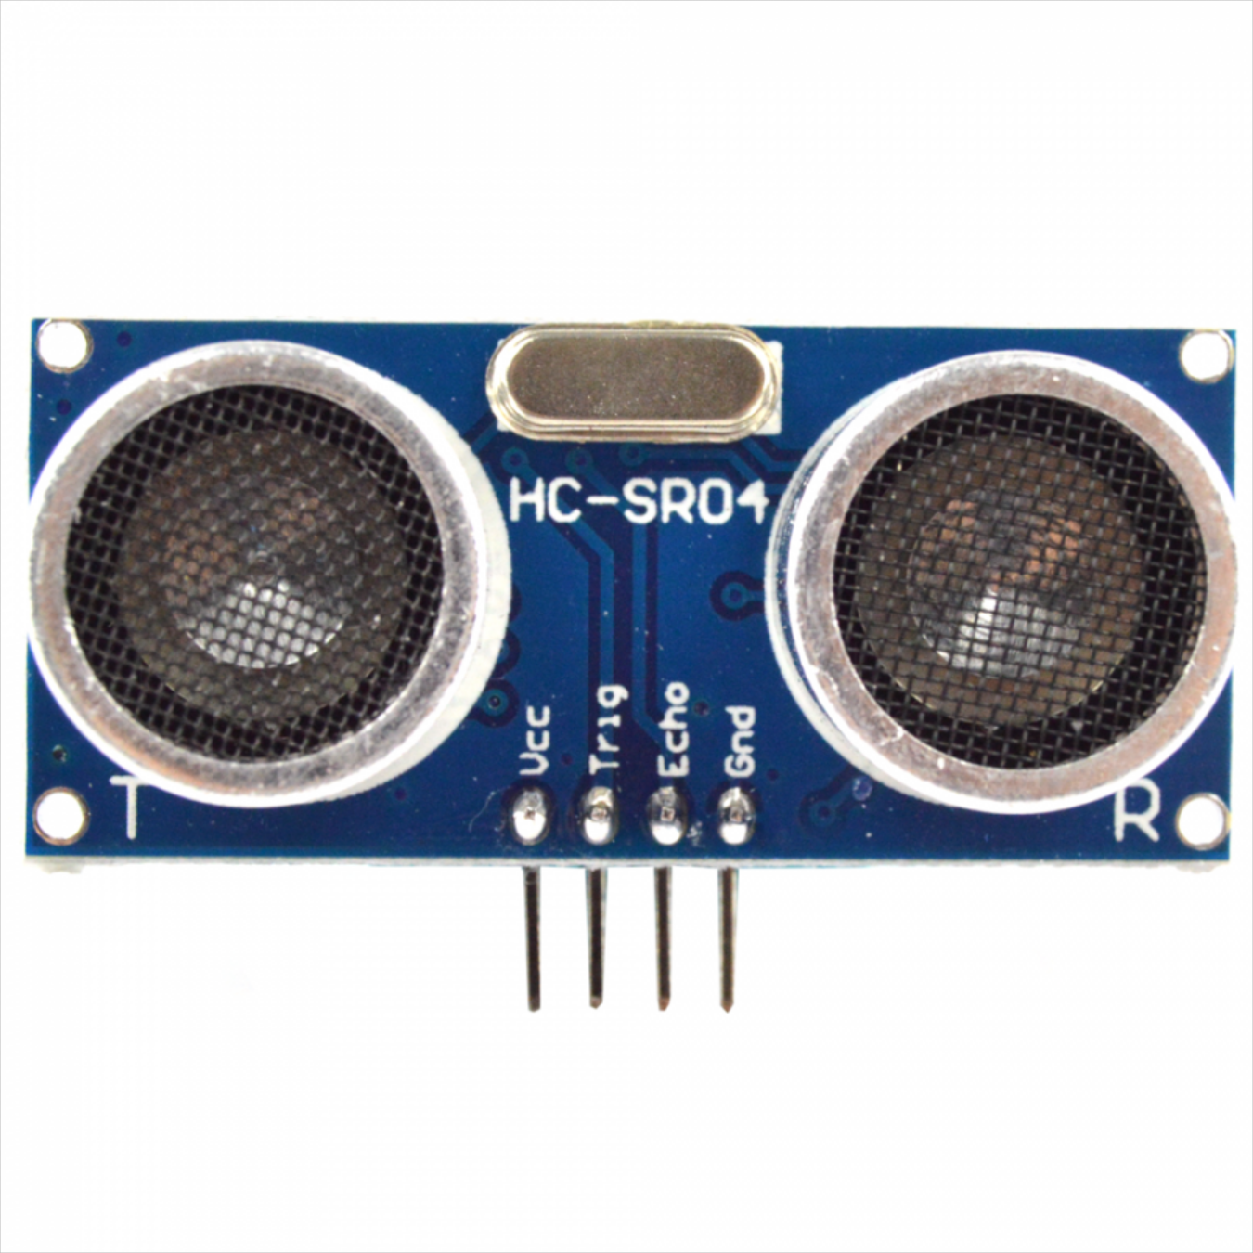
Specifications of HC-SR04
Working voltage: 5V
Outputs Frequency of 40KHz
Range: 2cm – 500cm (approx.)
Cycle Period: 50ms
Humans can hear sounds at frequencies from about 20Hz – 20KHz
Notes:
The HC-SR04 is the most commonly used ultrasonic sensor. It works from 5Volts. Unfortunately, It means that I will receive 5Volts which could damage the GPIO pins. Therefore, we will need a voltage divider, which we will talk later on. These sensors outputs frequency of 40KHz which is two time more that what humans can hear. The range of these sensors is between 2cm – 500 cm approximately. Which is they can measure distance up to 4-5 meters and are surprisingly accurate. Cycle period is the amount of time you should wait before taking measurements. The recommended cycle time for these sensors is minimum 50 milli seconds.

Slide 4
How it works
The HC-SR04 has 4 pins
VCC connects to the 5V pin
Trigger connects to a GPIO output pin
Echo connects to a GPIO input pin
Ground connects a ground pin
VCC
5V
Trigger
Ground
Echo
Notes:
The ultrasonic sensor has 4 pins: VCC, Trigg, Echo and Gnd. VCC stands for Voltage Common Collector. It is the power input pin of the sensor. The VCC pin connects to the 5V pin in the Raspberry Pi. Trigger activates the sensor and needs to be connected to a GPIO output. Echo returns the signal and it must be read by a GPIO input pin and therefore Echo connects to a GPIO input pin. Anf without much surprise, Ground connects to a ground pin.

Slide 5
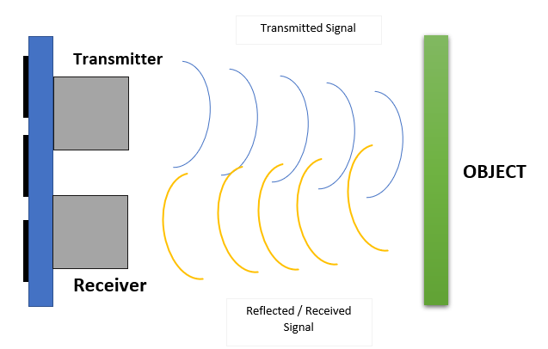
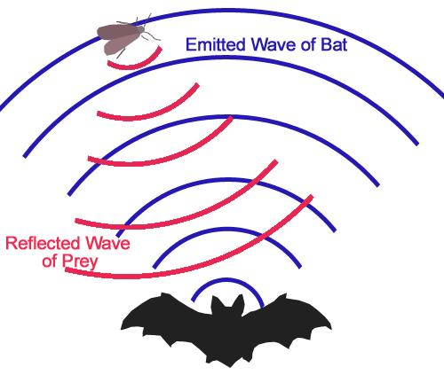
How it works…
This process is similar to how bats locate objects in their paths!
Notes:
Like mentioned before, these ultrasonic sensors have two components: Transmitter and Receiver. Transmitter transmits the signal from the sensor to the object in the form of ultrasonic waves. And receiver receives the reflected signal from the object. The sensor uses the time it takes for the sound to come back from the object in front to determine the distance of an object.
This process is similar to how bats locate objects in their paths. Bats sense distance using sound. They emit sound waves and receive back reflected waves. The time it takes to receive the waves back provides them with a very good estimate of the distance, which is exactly how ultrasonic sensors estimate distance.

Slide 6
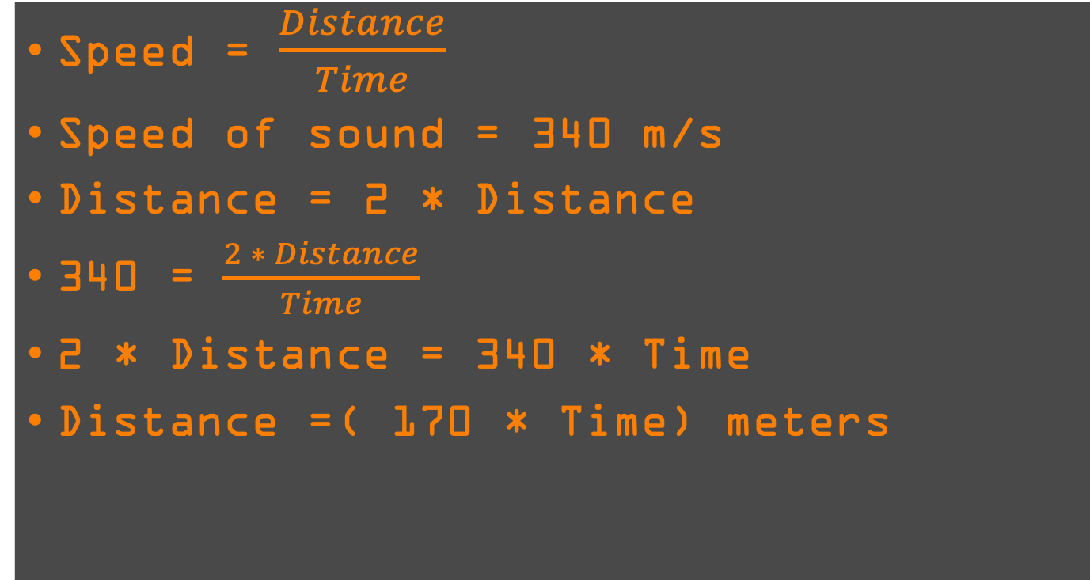
Calculating Distance
Notes:
We know that speed = distance/ time. Speed of sound = 340 m/s and distance = 2*Distance as the the wave travels to and from the object. Plugging the know values to the speed equation, we have 340 = 2*Distance/ Time. Rearranging this equation gives us Distance = 170 * Time in meters.

Slide 7
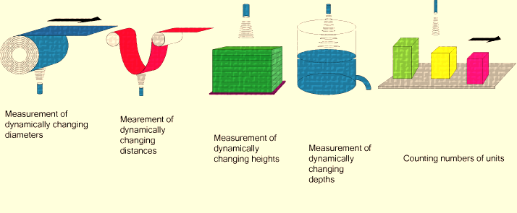
Applications for Ultrasonic Sensors
Presence
Level
Position
Distance
Diameter
Notes:
Ultrasonic sensors are very accurate and reliable. It can be used indoors or outdoors. Ultrasonic sensors make accurate measurements in many difficult environments and unusual materials. The measurements are unaffected by material, surface, light, dust and even mist and vapor. It can be used to measure the presence, level, position, distance and diameter.

Slide 8
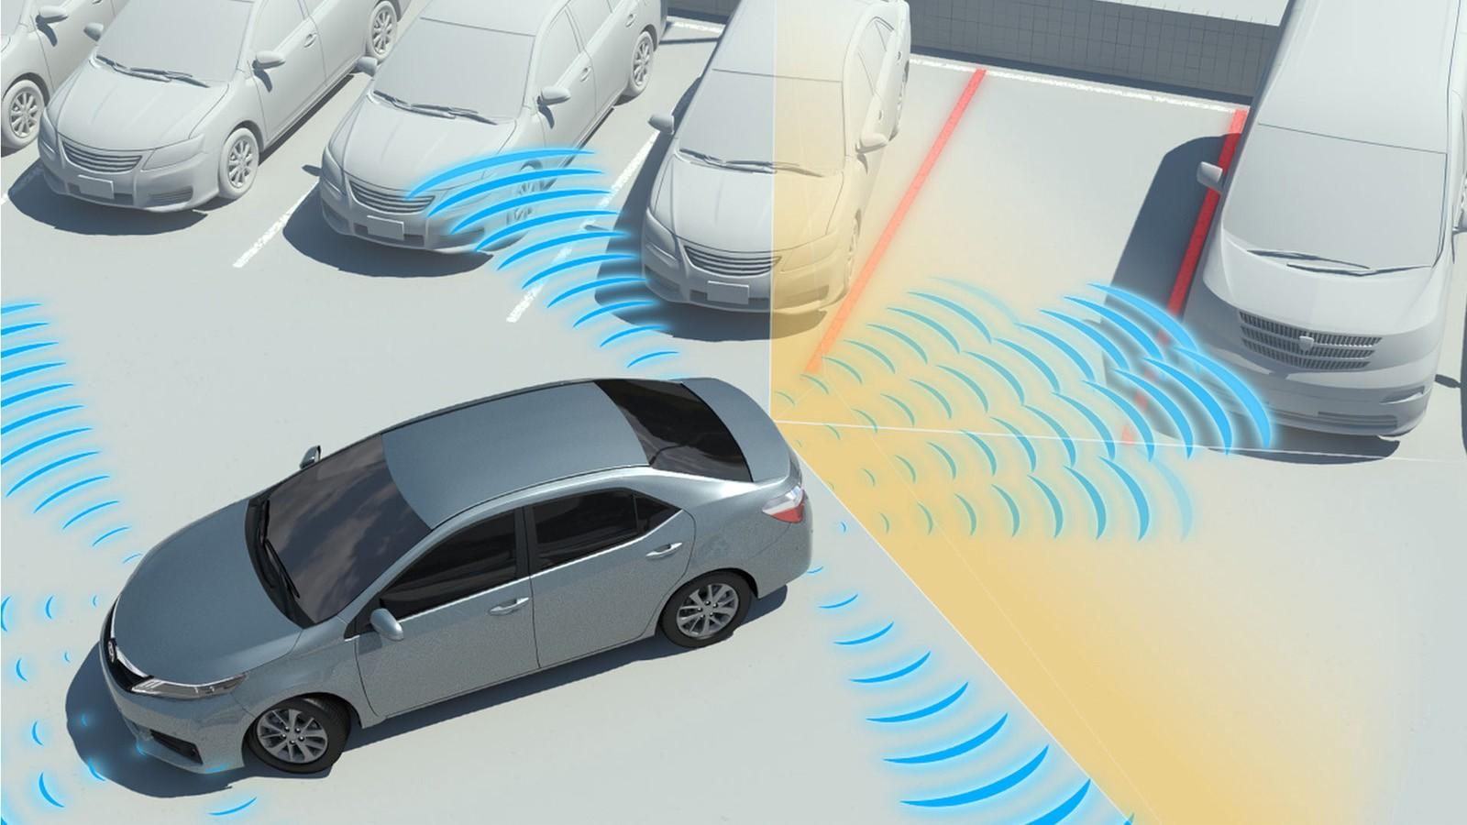
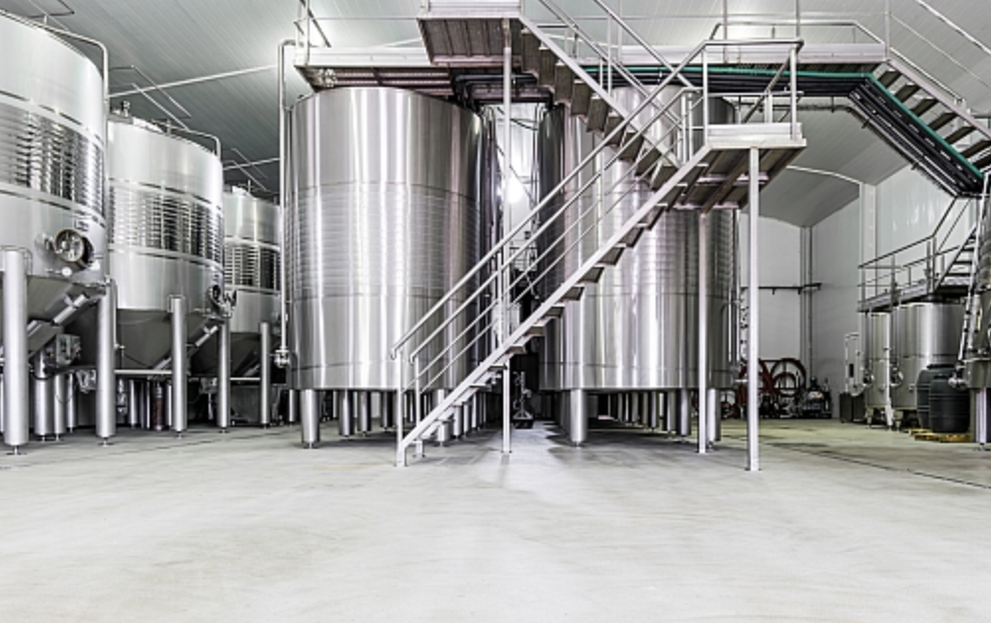
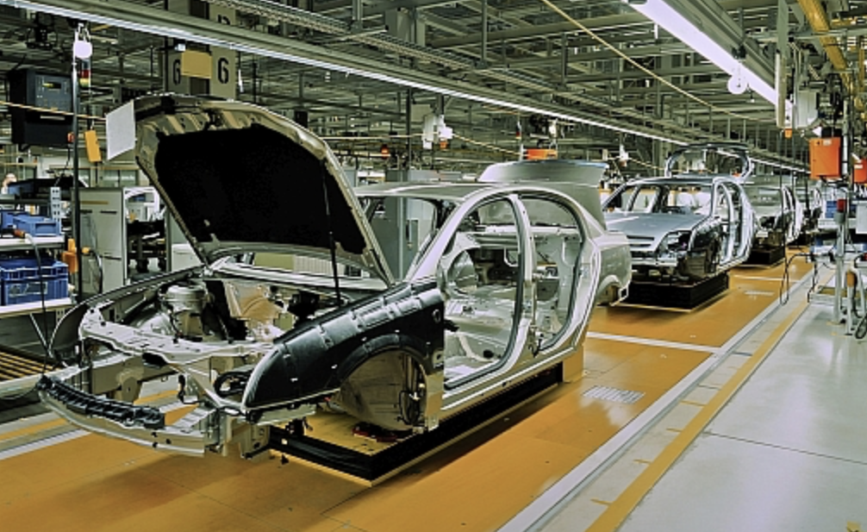
Applications for Ultrasonic Sensors
Notes:
It has been used in vehicles to support drivers with their driving tasks like parking and nearby obstacle detection.
Ultrasonic sensors are becoming widely accepted as an industry standard.
Ultrasonic sensors have a unique ability to detect uneven surfaces and return accurate distance data. The sensors are used in many applications where the detection of the level of a fluid in a container is needed. Typical industries include food and beverage, chemical and water treatment.
Pairs of ultrasonic sensors are used to accurately position objects. Linked together in a control system. the sensors provide the prime input for object location and position adjustment. Industries such as automotive, packaging, printing and assembly use ultrasonic sensors for their manufacturing process . They can also handle collision avoidance for a robot.

Slide 9
Check Progress
What is ultrasonic sensor?
How does ultrasonic sensor work?
How can we use Ultrasonic sensor in STEMBot?

Slide 10
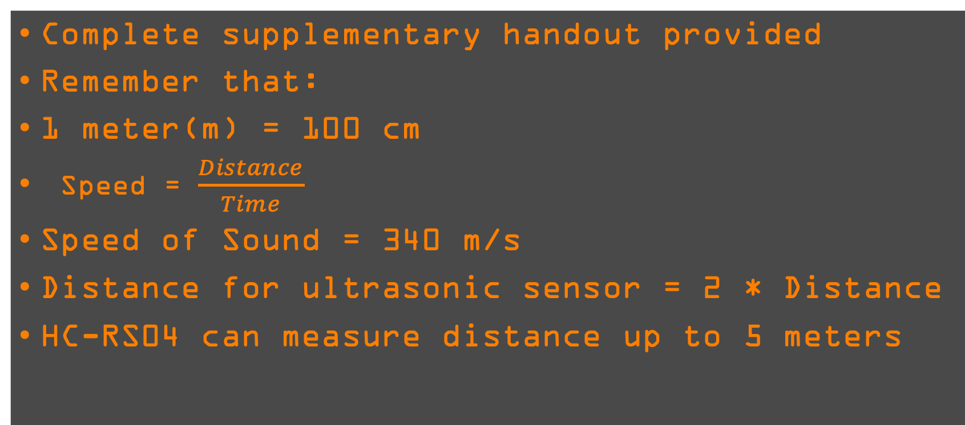
Check Progress

Slide 11
Questions?

